Slide 1

Portfolio Optimization
Group 6:
R.A.H
Reem AlQahtani
Afrah AlHarbi
Hussein Buhligah
Ahmed ALGhazal

Slide 2

Portfolio optimization is the process of selecting the best portfolio (asset distribution), out of the set of all portfolios being considered, according to some objective. The objective typically maximizes factors such as expected return, and minimizes financial risk.
PORTFOLIO OPTMIZATION

Slide 3
Project Steps
Collecting Data
Get all available tickers from the NASDAQ exchange.
Get historical data using yfinance library from (2005 to the end of 2021).
Drop assets were added after 2005.
Drop missing record.
Build Different Portfolio Optimization Algorithm.
Evaluate & Compare.

Slide 4

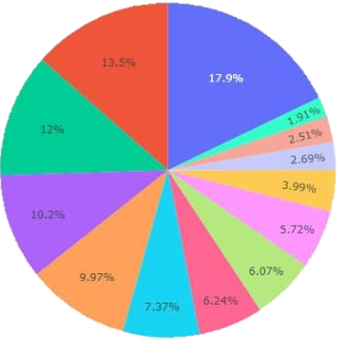

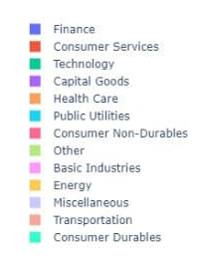
Data visualization

Slide 5

Back Testing & Simulation of Live Data
Historical Data
2005 - 2015
Live Data
2015 - 2022
Analyze Historical Data
Initial Allocation
Live Data For Period K
Performance Evaluation
Rebalance
K + 1

Slide 6
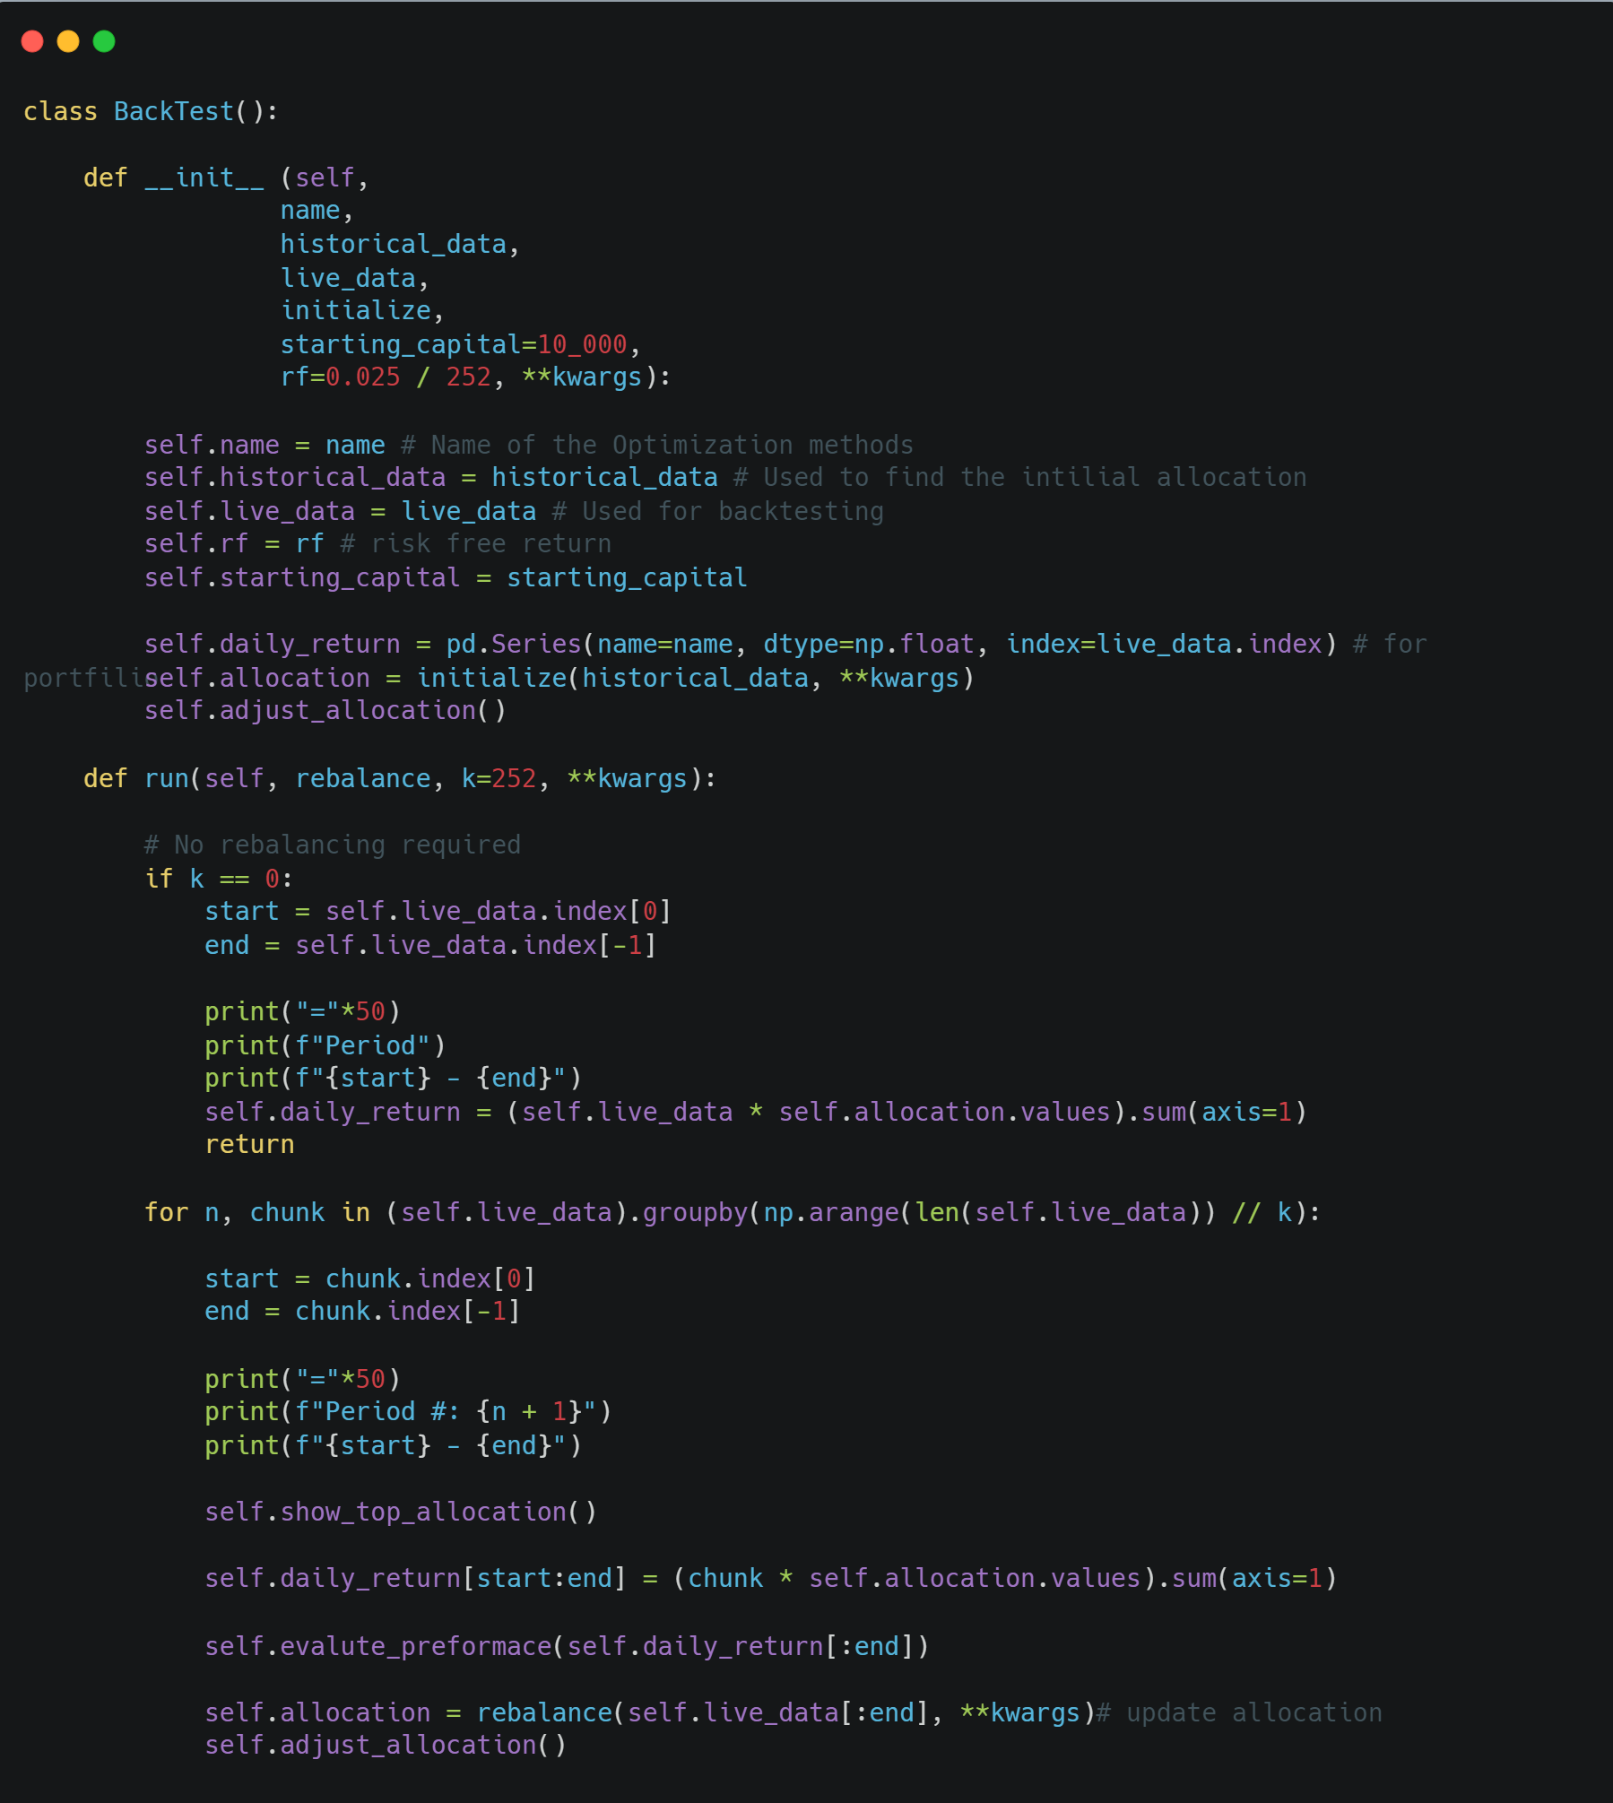
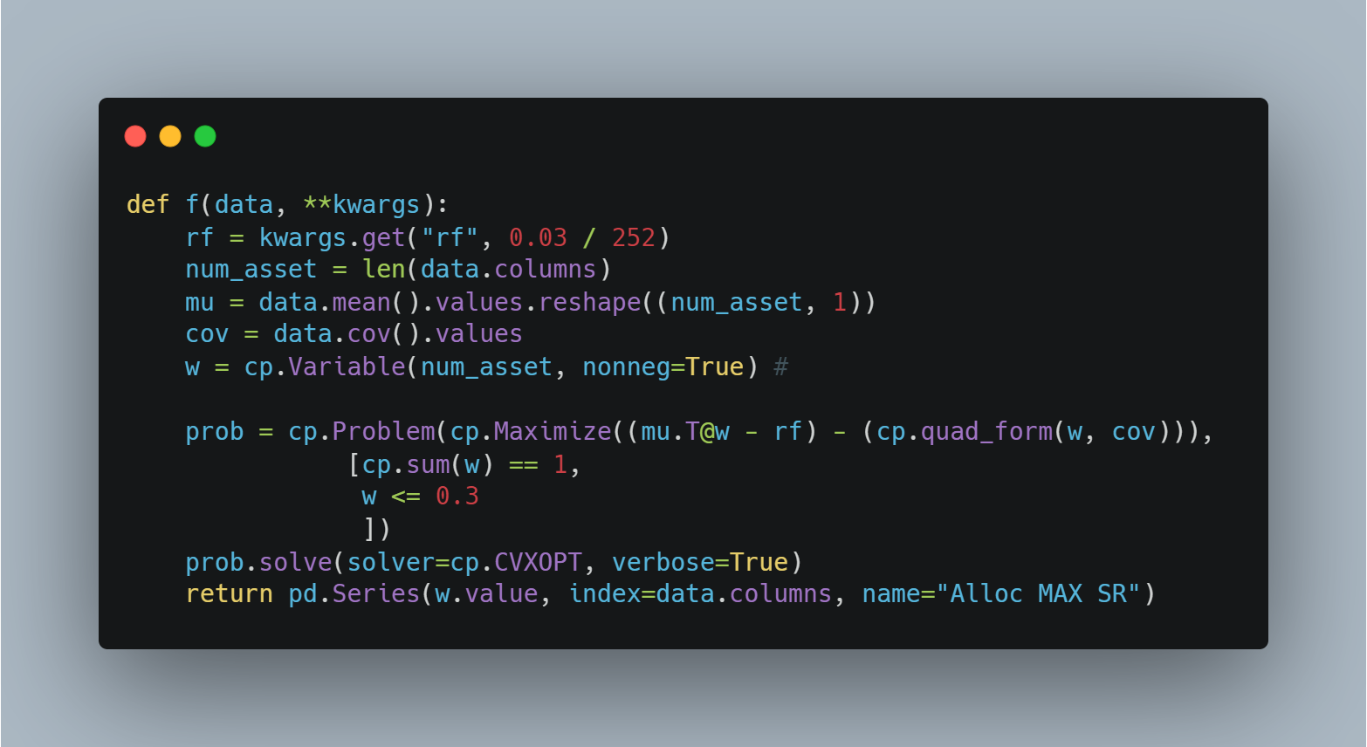
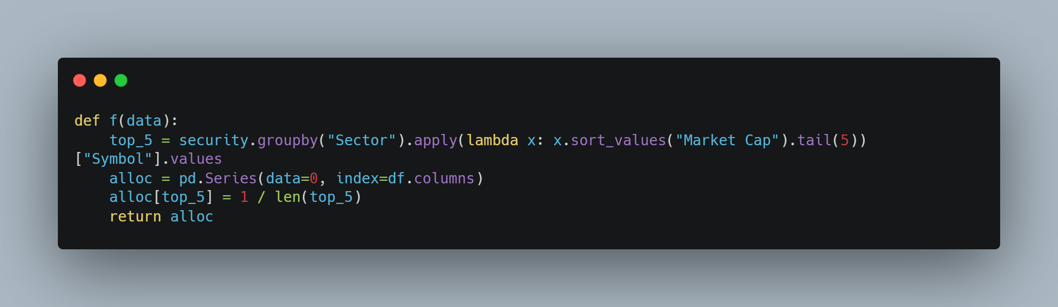
Walk-Forward-Test Simulation Code

Slide 7

Optimization Problem Solver
Monte Carlo Simulation(Brute Force)
Simple implementation.
Slow.
SciPy
Simple to use.
Valid for a wide-variety of problems.
Quadratic Solver
Need to write the problem as quartic program.
Valid for ONLY quadratic problem.
Valid to almost all problem.
Cannot handle large data.
Fast.
Very Fast.

Slide 8
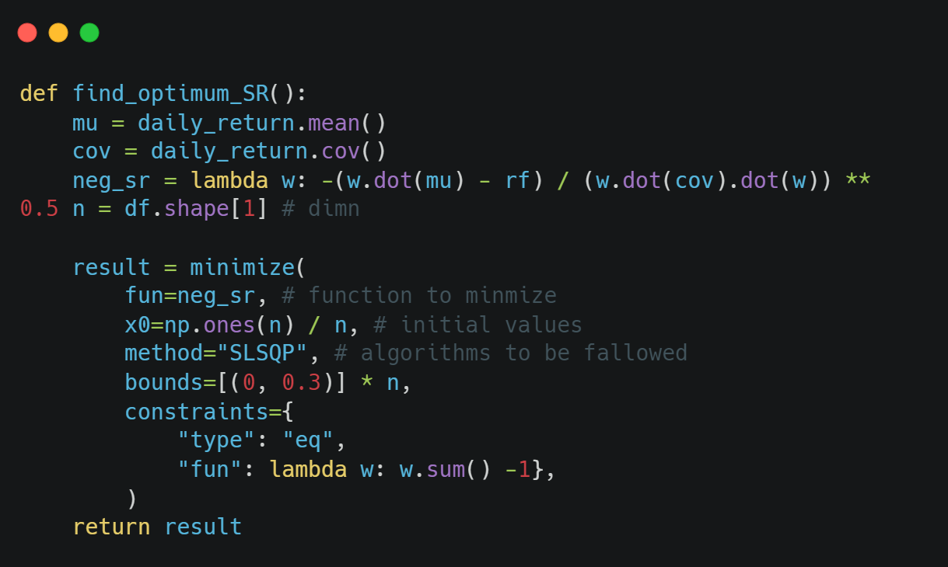
Optimization Problem Solver Code
SciPy Minimize
CVXPY

Slide 9
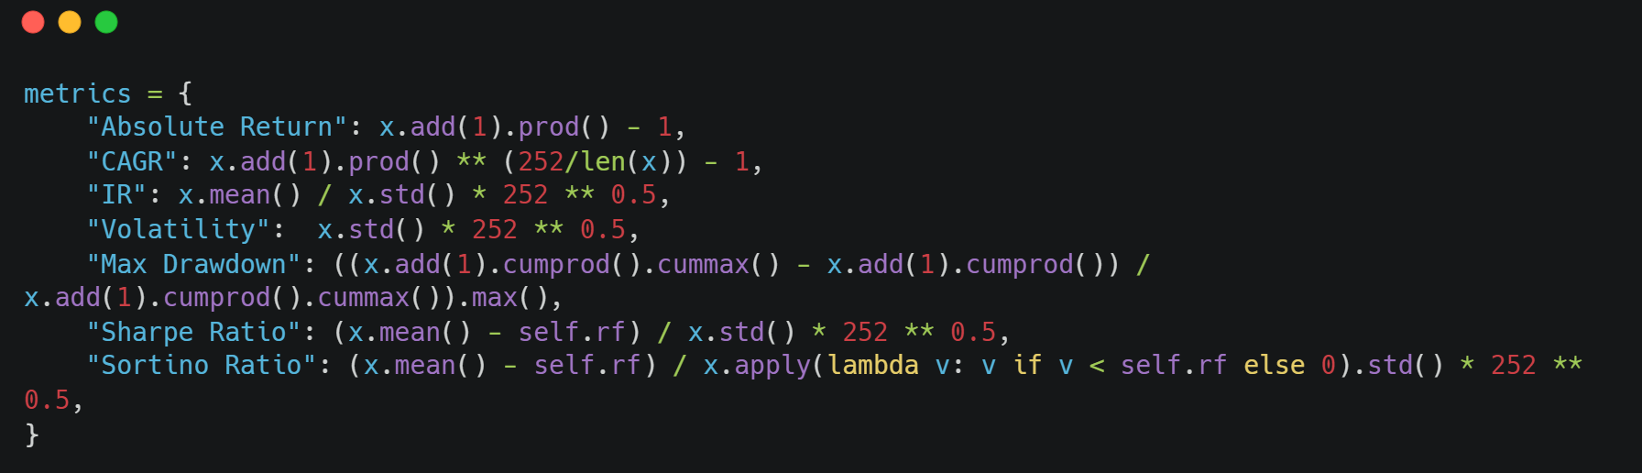
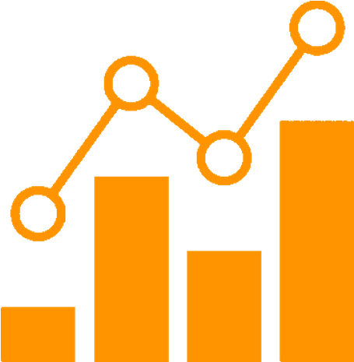
Performance Metrics
Absolute Return
CAGR
Information Ratio
Volatility (Standard Deviation)
Sortino Ratio
Sharpe Ratio
Max Drawdown

Slide 10
Portfolio optimization strategies
Equal Weight
Top 5 From Each Sector
Maximize Return
Maximize Sharpe Ratio
Minimize Volatility
Vanilla Risk Parity
K-Means

Slide 11
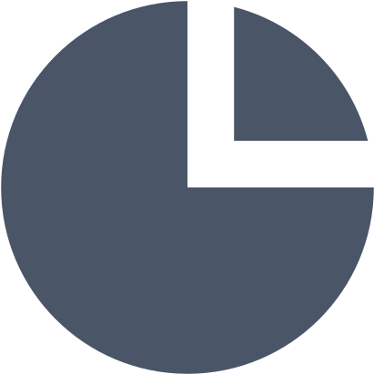
Portfolio Optimization Strategies
Equal Weight Portfolio
Top 5 From Each Sector
In this portfolio, we are gone invest equally among all assets. Therefore, it is straightforward and can be used as a benchmark for another complex model. Usually, a complex model will require some forecasting and estimation of the future, which is sometimes challenging. In addition, many optimizations algorithm fails to beat equal-weighted portfolio in the out-of-sample performance.
We will implement some filters to include only the five highest valued capital market assets from each sector. Therefore, we are hoping that we will have only the top performer (max return), and by choosing from all industries, we achieve diversification.

Slide 12
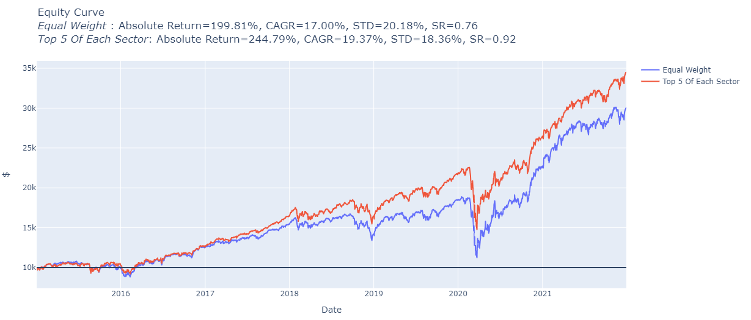
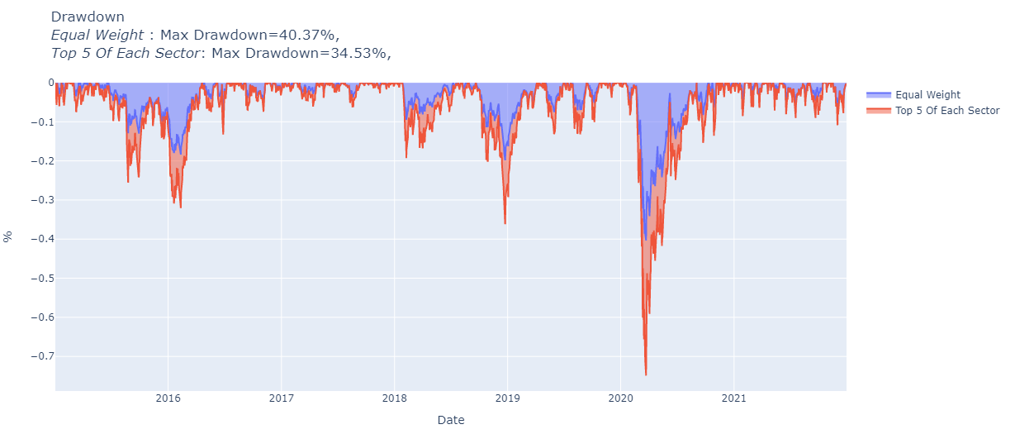
Performance Evaluation
x
Metrics | Equal Weight | Top 5
Absolute Return | 200% | 245%
CAGR | 17% | 19%
STD | 20% | 18%
SR | 0.76 | 0.92
Max Drawdown | 40% | 35%

Slide 13

Portfolio Optimization Strategies
Maximize Return
Maximize Sharpe Ratio
Minimize Volatility
Here we will try to invest while maximizing our return, we neglect risk completely. This can be used as a benchmark to see the worst risk for a mean-variance optimization problem.
Here we find the best allocation that gives the max Sharpe ratio. Sharpe ratio is considered risk-return adjusted metrics. Therefore, the weight that offers the max SR is the optimum trade-off between return and risk trying; trying to achieve more return will expose you to more trouble with little return gain.
One of the max-Sharpe ratio approach challenges is the expected return. Unfortunately, returns are notoriously complex and unreliable to predict. An alternative approach is to discard returns from the optimization and minimize risk, which is stander deviation.

Slide 14
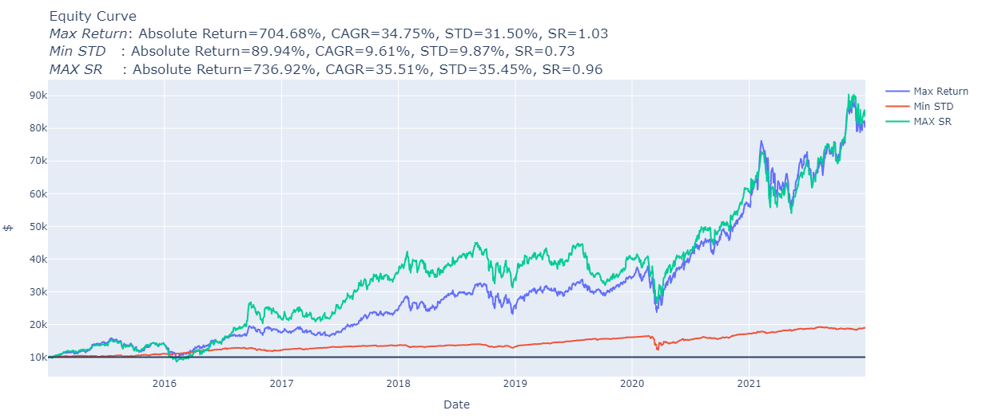
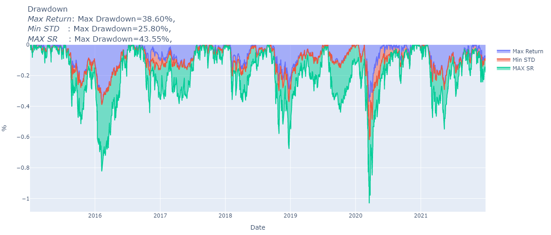
Performance Evaluation
x
Metrics | Max Return | Min STD | Max SR
Absolute Return | 705% | 90% | 737%
CAGR | 35% | 10% | 36%
STD | 32% | 10% | 35%
SR | 1.03 | 0.73 | 0.96
Max Drawdown | 39% | 26% | 44%

Slide 15
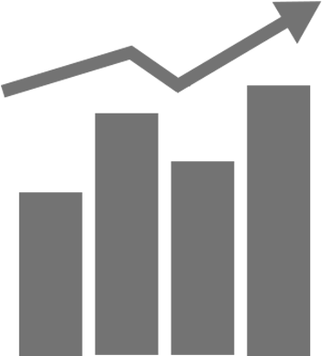
Portfolio Optimization Strategies
General Vanilla Risk Parity
K-Mean
The risk parity model allocates weight among assets to match risk level. This approach became popular after the 2008 financial crisis. Unfortunately, most models don’t consider risk diversification (risk concentration in few assets), resulting in tremendous losses during the financial crisis.
In this model, we will try to achieve diversification by grouping assets into k clusters, and then we will pick assets 5 out of each group, which has the highest Sharpe ratio, and invest in them. We are hoping by doing this that each asset belonging to the asset has similar behavior (diversification).

Slide 16
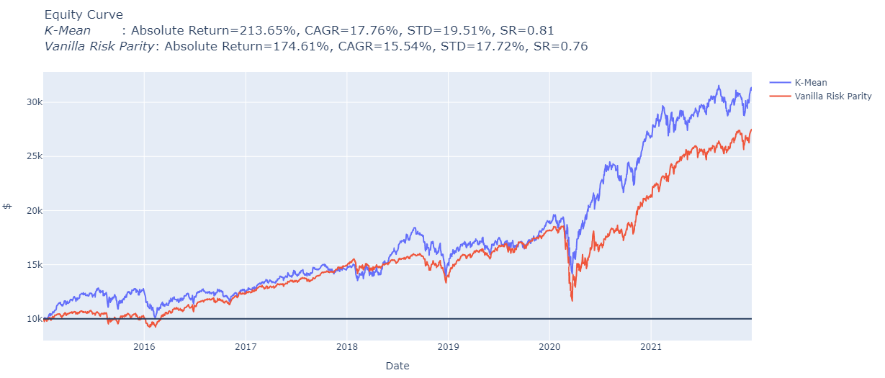
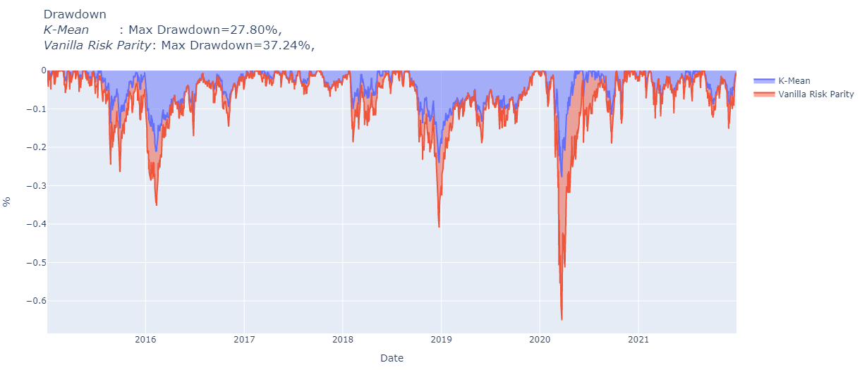
Performance Evaluation
x
Metrics | Risk Parity | K-Mean
Absolute Return | 175% | 214%
CAGR | 16% | 18%
STD | 18% | 20%
SR | 0.76 | 0.81
Max Drawdown | 37% | 28%

Slide 17
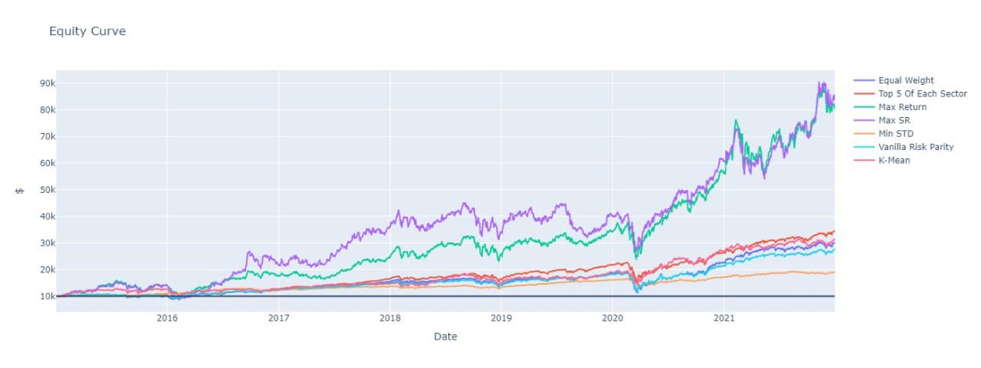

Final Results

Slide 18
Final Results
 | Equal Weight | Top 5 | Max Return | MAX SR | Min STD | Vanilla Risk Parity | K-Mean
Absolute Return | 1.998129 | 2.447927 | 7.046771 | 7.369228 | 0.899355 | 1.746102 | 2.136533
CAGR | 0.170035 | 0.193661 | 0.347477 | 0.35507 | 0.09609 | 0.155433 | 0.177611
IR | 0.879946 | 1.056626 | 1.105443 | 1.03512 | 0.979333 | 0.904674 | 0.936083
Volatility | 0.201826 | 0.183607 | 0.315046 | 0.354529 | 0.098747 | 0.177239 | 0.195091
Max Drawdown | 0.40367 | 0.345325 | 0.385955 | 0.435518 | 0.25799 | 0.372407 | 0.277969
Sharpe Ratio | 0.756077 | 0.920465 | 1.026089 | 0.964604 | 0.726161 | 0.763622 | 0.807938
Sortino Ratio | 1.157328 | 1.413849 | 1.644555 | 1.592494 | 1.007794 | 1.15281 | 1.294711

Slide 19
Result Summery
CAGR(High - Low) |  | Volatility(Low - High)
Max SR | 36% | Min STD | 10%
Max Return | 35% | Risk Parity | 18%
Top 5 | 19% | Top 5 | 18%
K-Mean | 18% | K-Mean | 20%
Equal Weight | 17% | Equal Weight | 20%
Risk Parity | 16% | Max Return | 32%
Min STD | 10% | Max SR | 35%
 | K-Mean | Top 5 | Risk Parity | Equal Weight
Max Drawdown | 28% | 35% | 37% | 40%

Slide 20

conclusion
We hope that by understanding the characteristic of each method, we can build upon it as starting point for other investment solutions/Robo-advisor and even can be used as a reference for other investors to choose what fit their requirements and conditions.

Slide 21
Thank you
Any Question?

